Slide 1
MINI PROJECT RANDOM PASSWORD GENERATOR
G MONESHA
312821205020
IT DEPARTMENT

Slide 2
AGENDA
Abstract and Scope
Introduction
Key Aspects
Proposed System
Software Requirements
Methodology
Result and Conclusion

Slide 3
ABSTRACT AND SCOPE
ABSTRACT
A random password generator is a tool designed to create strong, unpredictable passwords to enhance security. By combining uppercase and lowercase letters, numbers and special characters, it produces passwords resistant to hacking attempts. Users define the password length, ensuring both flexibility and security. This tool simplifies the creation of secure passwords, playing a key role in protecting digital identities and sensitive data.
SCOPE
This random password generator aims to create strong, secure passwords. Users can specify the desired password length, ensuring tailored security. The generator is designed for ease of use, helping individuals and organizations enhance their password practices and protect sensitive information from unauthorized access.

Slide 4
INTRODUCTION
A random password generator is a tool that creates complex and unpredictable passwords for users, enhancing security by minimizing the risk of unauthorized access to sensitive information. These generators typically use algorithms to produce passwords containing a mix of letters, digits and special character. The goal is to create passwords that are difficult to guess or crack through brute force attacks. By using a random password generator, users can ensure their passwords are unique and strong, providing better protection against potential cyber threats.
KEY ASPECTS
1. Randomness: The generator should produce truly random and unpredictable passwords to prevent patterns that could be exploited by attackers.
2.Complexity: Passwords should include a mix of uppercase and lowercase letters, digits and special characters to enhance security and make them harder to crack.

Slide 5
3.Length: Longer passwords are generally more secure, so the generator should allow for passwords of varying length, typically recommending a minimum of 12-16 characters.
4.User preference: The generator should offer customizable options, allowing users to specify the types of characters included and the desired password length.
5.Security of generation process: The process of generating the password should be secure, ensuring that the generated passwords are not leaked or stored insecurely.
6. Accessibility and No-repetition: The generator should be easy to use, providing a simple interface for users. The generator should ensure that the same password is not generated twice in a short period and should be trained with uniqueness.
PROPOSED SYSTEMS
Creating a random password generator using Python involves several steps to ensure the generated passwords are secure and meet the desired criteria. Below is a proposed system for a Python-based random password generator:

Slide 6
1. System Design
Input Parameters: The system should allow users to specify the length of the password and any specific character requirements (e.g., inclusion of special characters).
Character Set: Define the character set from which the password will be generated, including:
Lowercase letters (a-z)
Uppercase letters (A-Z)
Numbers (0-9)
Special characters (e.g.,!@#$%^&*())
Randomization: Use Python’s random or secrets module to ensure randomness in password generation.
Validation: Check the generated password to ensure it meets all specified criteria.

Slide 7
2. Features
Customizable Length and Character Types: Users can specify the length and choose which types of characters to include in the password.
Security Considerations: The use of Python’s random module is suitable for most purposes, but for cryptographic security, consider using the secrets module.
Extensibility: This basic implementation can be extended with additional features like avoiding similar characters, ensuring minimum counts of each character type, or integrating with a password manager.
3. Testing and Validation
Test Cases: Develop test cases to validate different scenarios, such as generating passwords with different lengths and character types.
Edge Cases: Test edge cases like minimum length, only one type of character, etc.

Slide 8
Software Requirements
Python Environment:
Install Python (preferably the latest version, e.g., Python 3.10 or above) to ensure access to the latest features and security updates.
Standard Python Libraries:
string: Provides a convenient way to access sets of characters like ASCII letters, digits, and punctuation.
random or secrets: The random module is suitable for general purposes, while the secrets module is preferred for cryptographically secure random numbers.
IDE or Text Editor:
Use a Python-friendly Integrated Development Environment (IDE) such as PyCharm, VSCode, or any other text editor like Sublime Text or Atom that supports Python syntax highlighting and extensions

Slide 9
4. Version Control System:
Implement version control using Git to manage changes, track history, and collaborate with others if necessary.
5. Optional - GUI Library:
If you plan to create a graphical user interface (GUI), consider libraries like tkinter (standard library), PyQt, or Kivy.
6. Testing Framework:
Use a testing framework like unit test (part of the Python standard library) or pytest to ensure the correctness and reliability of the password generator.

Slide 10
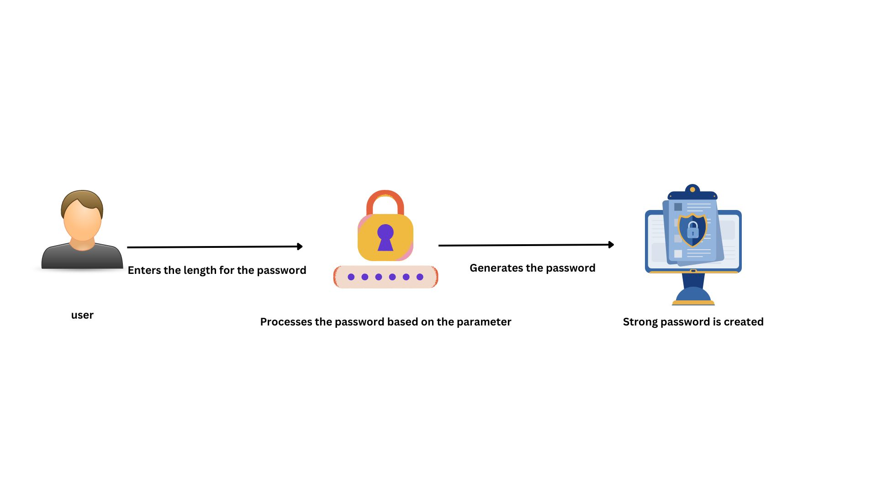
METHODOLOGY
The methodology for developing a random password generator using Python involves a systematic approach to ensure the application is secure, efficient, and user-friendly. Below is a detailed methodology that you can follow:

Slide 11
1. Requirement Analysis
Define Requirements: Determine the necessary features, such as password length, character types (uppercase, lowercase, digits, special characters), and any specific user preferences.
Security Considerations: Identify security requirements to ensure generated passwords are strong and unpredictable.
2. Design
System Architecture: Outline the architecture of the password generator, specifying how different components interact, such as user input, password generation logic, and output.
Character Set Definition: Design the character sets that the generator will use, including alphabets, numbers, and special characters.
Algorithm Design: Plan the logic for random password generation, including how to ensure randomness and meet the specified criteria.
3. Implementation
Code Development: Write the code for the password generator, ensuring it adheres to the design specifications.

Slide 12
Use Python’s random or secrets module for generating random characters.
Use the string module for accessing character sets.
Interface Development: Create a user interface, which could be a simple command-line tool or a graphical interface using tkinter.
4. Testing
Unit Testing: Develop test cases to verify that the password generator works as expected, covering various lengths and character combinations.
Security Testing: Test the randomness and strength of the generated passwords to ensure they meet security standards.
Usability Testing: Ensure that the user interface is intuitive and easy to use.
5. Deployment
Packaging: Package the application for distribution, using tools like setup tools to create an installable package.

Slide 13
6. Maintenance
Updates: Regularly update the software to address any security vulnerabilities and add new features.
User Feedback: Collect and incorporate user feedback to improve the password generator’s functionality and user experience.
RESULT AND CONCLUSION
Results
Increased Security: Random passwords generated are typically much stronger than user-generated passwords, providing a higher level of security against unauthorized access.
Complexity: These passwords often include a mix of uppercase and lowercase letters, numbers, and special characters, making them more complex and harder to crack.
3. Uniqueness: Each generated password is unique, reducing the risk of a single password breach compromising multiple accounts.

Slide 14
4. Length: Longer passwords, often 12 characters or more, are generated, which significantly enhances security by increasing the number of possible combinations.
Conclusion
Adoption: Organizations and individuals should adopt random password generators as a standard practice to enhance security and protect sensitive data.
Education: Users need to be educated about the importance of strong, unique passwords and the benefits of using password generators.
Integration: Password managers should be integrated with random password generators to facilitate easy storage and management of complex passwords.
Automation: Automating password creation and rotation can significantly reduce the risk of using weak or reused passwords.
REFERENCES
https://secureblitz.com/
https://stackoverflow.com/questions/3854692/generate-password-in-python
https://www.w3schools.com/python/module_random.asp
https://www.techopedia.com/tools/password-generator
Notes:
Length: Longer passwords, often 12 characters or more, are generated, which significantly enhances security by increasing the number of possible combinations.
Conclusion
Adoption: Organizations and individuals should adopt random password generators as a standard practice to enhance security and protect sensitive data.
Education: Users need to be educated about the importance of strong, unique passwords and the benefits of using password generators.
Integration: Password managers should be integrated with random password generators to facilitate easy storage and management of complex passwords.
Automation: Automating password creation and rotation can significantly reduce the risk of using weak or reused passwords.

